Slide 1
Modernização de aplicativos
Jaqueline Ramos
Rodrigo Guerra
Cloud Solution Architects | App Dev & Infra
One Commercial Partner

Slide 2

Resumo e objetivos de aprendizagem
Nesta whiteboard session, você trabalha com um grupo para projetar uma solução para modernizar aplicativos e infraestrutura locais herdados, aproveitando os serviços em nuvem. Como parte do esforço de modernização, os aprimoramentos de aplicativos são adicionados usando uma mistura de serviços da Web e móveis, todos protegidos pelo Azure Active Directory.
No final deste whiteboard session, sua capacidade de projetar um plano de modernização para organizações que desejam mover serviços do local para a nuvem será aprimorada.

Slide 3
Etapa 1: revise o estudo de caso do cliente
Resultado
Analise as necessidades de seus clientes.
Prazo
5 minutes

Slide 4

Situação do cliente
A Contoso, Ltd. fornece uma gama completa de serviços de seguros de longo prazo para ajudar pessoas com seguro insuficiente.
Eles estão tentando lidar com a sobrecarga devido ao crescimento mais rápido do que o esperado.
Notes:
Contoso Ltd. is a new company in a very old business. Founded in Auckland, New Zealand, in 2005, by senior life insurance executives, the ambitious new company provides a full range of long-term insurance services to help people who are underinsured.
Almost from the start, the company grew far faster than anticipated. An avalanche of business meant that the original processes created to manage policy documentation became overloaded. Employees struggled to cope, even as the headcount rose from five to 110 during the first year.

Slide 5

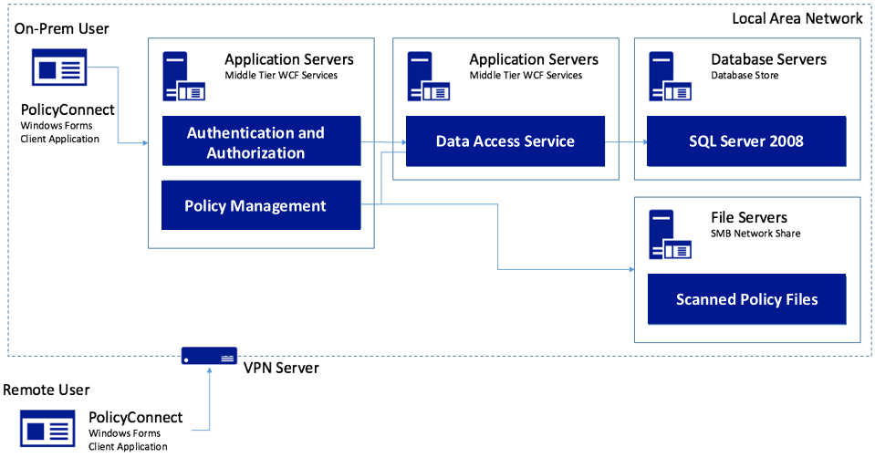
Situação do cliente - 2
A Contoso, Ltd. criou um aplicativo Windows Forms personalizado chamado PolicyConnect para seus funcionários gerenciarem as informações do titular da apólice.
Seus dados são armazenados em um banco de dados do SQL Server 2008 e em um servidor de arquivos na rede local.
Notes:
Contoso Ltd. implemented PolicyConnect, a custom Windows Forms application used by their staff to input key metadata that includes policy holder information such as insured amount, beneficiary, policy type, and any deductible and out of pocket requirements.
Contoso employees access this application which ultimately stores its data in a SQL Server 2008 database, and a file server on their local area network.

Slide 6



Situação do cliente - 3
Os funcionários confiam no email como um mecanismo de fluxo de trabalho para tarefas de gerenciamento de documentos.
Deseja opções para obter insights sem exigir desenvolvimento personalizado a cada vez.
Quer disponibilizar o sistema de segurados por meio de aplicativos da Web e móveis sem VPN.
Notes:
Contoso employees rely on email as a workflow engine relative to the document management tasks. They are using Office 365.
Executive leadership have frequent challenges in gauging productivity and throughput given the manual workflow—they feel that are blocked in quickly getting to the insights they need because each new question seems to need more custom development.
Wants to make their policy holder system available to its employees and brokers via web and mobile applications without requiring VPN, and store policies in cloud storage for retrieval via the new apps.
They would like to migrate their SQL Server based database to SQL Database

Slide 7




Situação do cliente - 4
Gostaríamos de garantir que nosso banco de dados não seja sobrecarregado, mostre um painel com estatísticas do usuário, permita que não desenvolvedores de outros departamentos façam aplicativos móveis e aprimore a segurança protegendo os segredos dos aplicativos.
Você pode nos ajudar a fazer isso?
Notes:
Want to ensure they employ best practices for mitigating the impact of repeated querying of the database
Looking to implement a scoreboard of sorts that tracks the most active users in a 24-hour period, as well as approximate the number of operations that user performed with the system in perpetuity
Want to make sure they have a streamlined way for internal departments to quickly build their own apps to automate time saving micro-processes without having to involve the PolicyConnect development team or ideally, even developers
Improve security by externalizing secrets such as connection strings from the web apps and APIs, and storing them in an encrypted location accessible only to authorized services
Contoso has multiple development teams and is concerned about duplication of effort and change management as they move more business logic to APIs. They also are considering opening a subset of APIs to a network of affiliated partners.

Slide 8






Necessidades do cliente - 5
Modernize nossa arquitetura
Ir para celular
Permitir que funcionários não desenvolvedores criem aplicativos
Melhore o gerenciamento de segredos de aplicativos
Adicionar pesquisa cognitiva
Use tecnologias de API sem servidor
Migrar para o serviço de banco de dados SQL totalmente gerenciado
Adicione cache à nossa solução

Slide 9

Objeções do cliente
Como podemos automatizar nossos processos?
O Microsoft Flow substituirá os Logic Apps?
Existe realmente uma maneira de armazenar com segurança segredos de aplicativos na nuvem?
Não temos todos os recursos SQL disponíveis para nós na nuvem.
Nosso inventário de API aumentará e estamos preocupados com a melhor maneira de gerenciar isso.
Quer entender como escolher o .NET framework correto

Slide 10
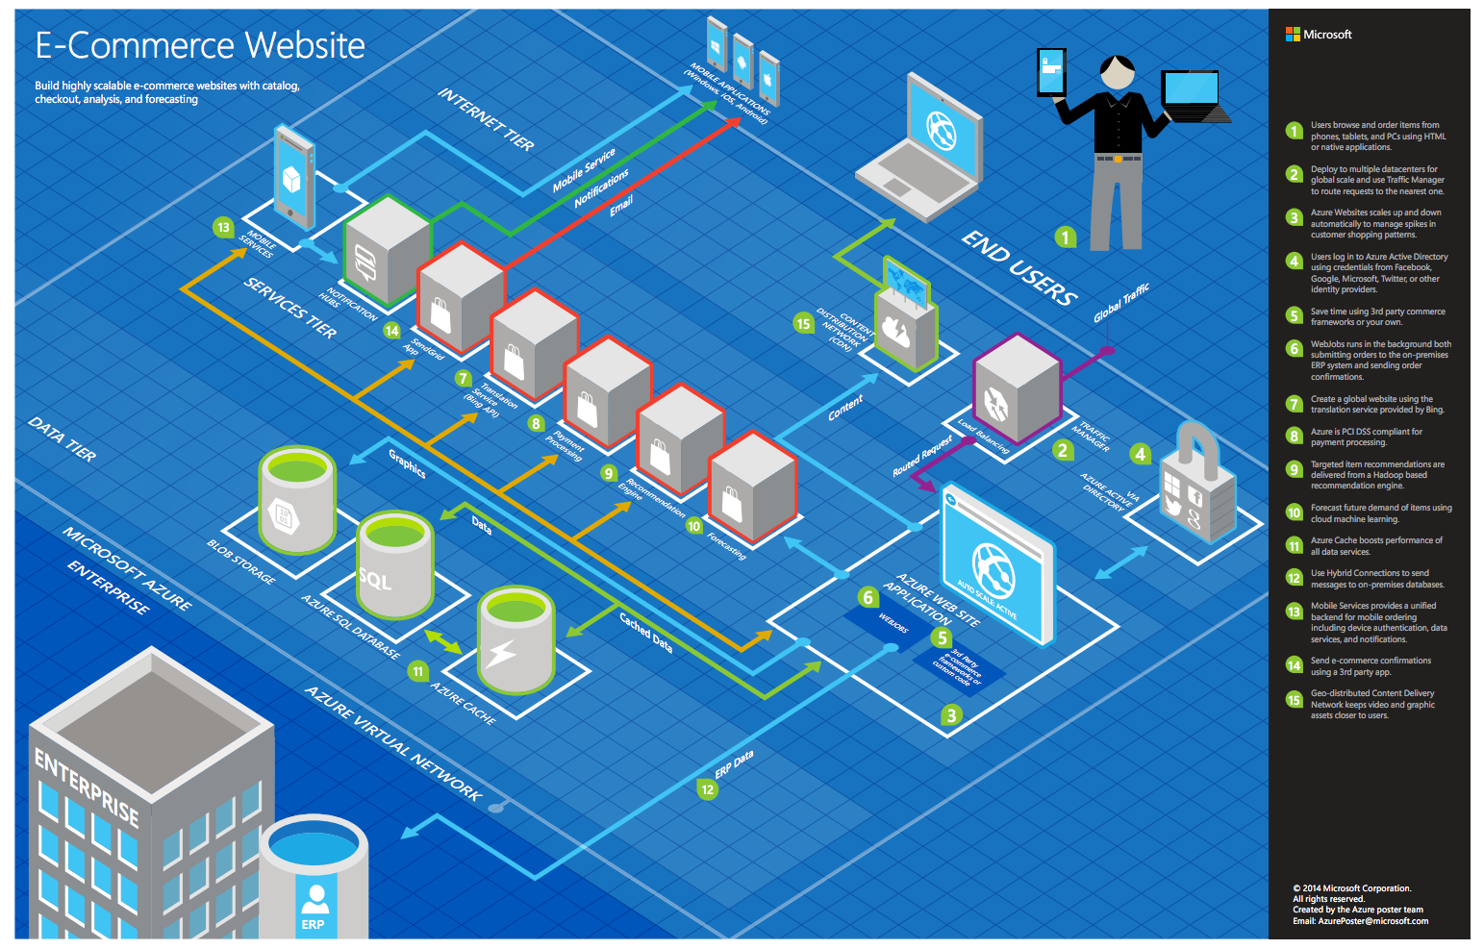
Cenários comuns
Notes:
This is a diagram of a common architecture for this type of scenario, that you can draw inspiration from. You will find this diagram within the learner guide.

Slide 11
Etapa 2: projetar a solução
Resultado
Crie uma solução e prepare-se para apresentá-la ao público-alvo em um formato de 5 minutos.
Prazo
30 minutes
Business needs (5 minutes) | Respond to questions outlined in your guide and list the answers on a flipchart.
Design (15 minutes) | Design a solution for as many of the stated requirements as time allows. Show the solution on a flipchart.
Prepare (10 minutes) | Identify any customer needs that are not addressed with the proposed solution. Identify the benefits of your solution. Determine how you will respond to the customer’s objections. Prepare for a 5-minute presentation to the customer.

Slide 12
Etapa 3: apresentar a solução
Resultado
Apresente uma solução para o cliente-alvo em um formato de 5 minutos.
Prazo
10 minutes (5 minutes for each team to present and receive feedback)
Instruções
Emparelhe com outra mesa.
Uma mesa é a equipe da Microsoft e a outra mesa é o cliente.
A equipe da Microsoft apresenta sua solução proposta ao cliente.
O cliente solicita uma das objeções da lista de objeções no estudo de caso.
A equipe da Microsoft responde à objeção.
A equipe do cliente fornece feedback para a equipe da Microsoft.

Slide 13
Encerramento
Resultado
Identifique a solução preferida para o estudo de caso. Identifique soluções projetadas por outras equipes.
Prazo
10 minutes

Slide 14

Público-alvo preferido
Charlene Mathis, Gerente Geral, Contoso Ltd
O público principal são tomadores de decisão de negócios e tecnologia.
Normalmente, conversamos com os gerentes de infraestrutura que se reportam aos CIOs ou aos patrocinadores de aplicativos (como um VP LOB, CMO) ou àqueles que representam a TI da unidade de negócios ou aos desenvolvedores que se reportam aos patrocinadores de aplicativos.

Slide 15
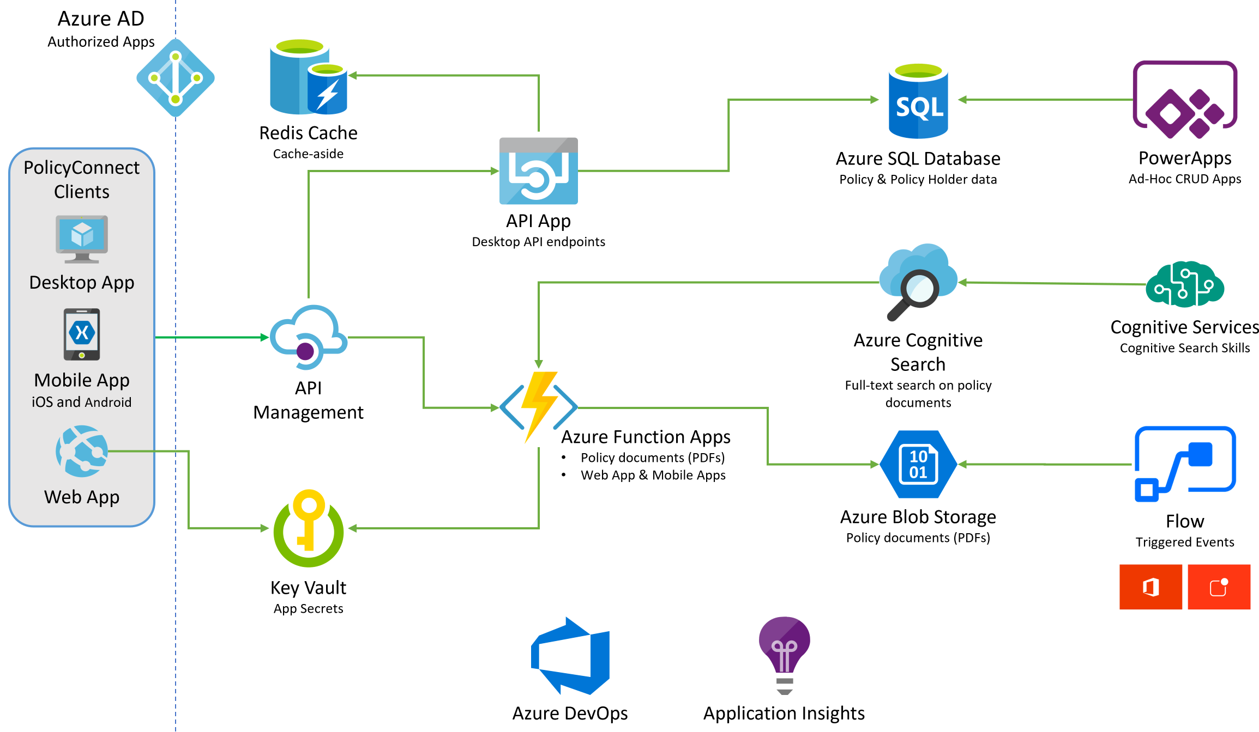
Solução preferida
Notes:
The solution begins with migrating Contoso's SQL Server 2008 R2 database to Azure SQL Database using the Azure Database Migration Service. After performing an assessment using the Data Migration Assistant, Contoso was able to determine that there were no compatibility issues or unsupported features to prevent them from migrating into a fully-managed SQL database service in Azure. Next, the web and API apps are migrated into Azure App Services. In addition, mobile apps, built for Android and iOS using Xamarin, are created to provide access to PolicyConnect. The website, hosted in a Web App, provides the user interface for browser-based clients, whereas the Xamarin Forms-based apps provide the UI to mobile devices. Both the mobile app and website rely on web services hosted in a Function App, which sits behind API Management. An API App is also deployed to host APIs for the legacy Windows Forms desktop application. Light-weight, serverless APIs are provided by Azure Functions and Azure Functions Proxies to provide access to the database and policy documents stored in Blob Storage. Azure API Management is used to create an API Store for development teams and affiliated partners. Sensitive configuration data, like connection strings, are stored in Key Vault and accessed from the APIs or Web App on demand so that these settings never live in their file system. The API App uses the Azure Redis Cache to implement the cache aside pattern, caching data as it is retrieved from SQL Database. A full-text cognitive search pipeline is used to index policy documents in Blob Storage. Cognitive Services are used to enable search index enrichment using cognitive skills in Azure Cognitive Search. PowerApps enable authorized business users to build mobile and web create, read, update, delete (CRUD) applications that interact with SQL Database and Azure Storage, while Microsoft Flow enables them to orchestrations between services such as Office 365 email and services for sending mobile notifications. These orchestrations can be used independently of PowerApps or invoked by PowerApps to provide additional logic. The solution uses user and application identities maintained in Azure AD.

Slide 16
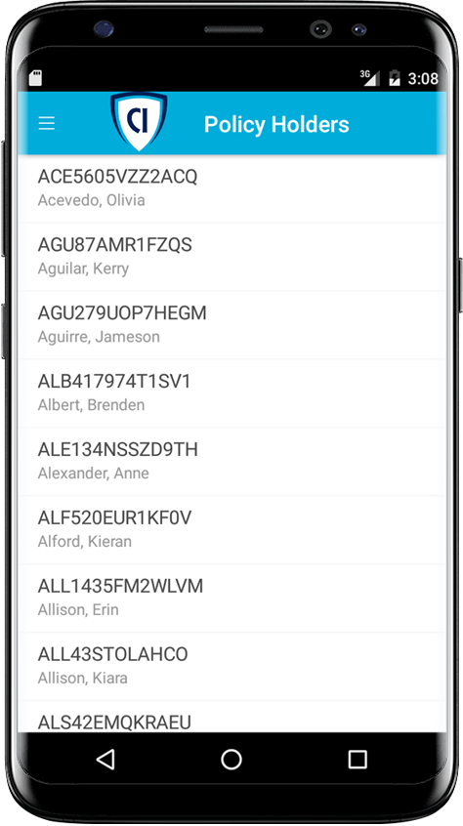



Solução preferida - 2
Aplicativos para celular e Web
Crie dispositivos móveis com o Xamarin
Use um aplicativo de API para o back-end
Hospedar site com um aplicativo Web
Usar Proxies das Funções do Azure
Notes:
How should Contoso implement the PolicyConnect mobile app?
- Utilize Xamarin within Visual Studio
What Azure service would host the services supporting the mobile app backend? Would you suggest a Mobile App or an API App? Why?
- In this scenario, either one would work because API Apps and Mobile Apps expose the same functionality that Contoso needs to support the Web App and the APIs that are behind the Web App and the Xamarin mobile application.
What Azure service would host the web site?
- A Web App
What Azure service would provide a light weight, serverless API solution for retrieving policy documents from Azure blob storage?
- Azure Functions Proxies provide an easy way to create serverless APIs, providing a way to break large APIs into multiple function apps (as in a microservices architecture), while still presenting a single API surface for clients.

Slide 17
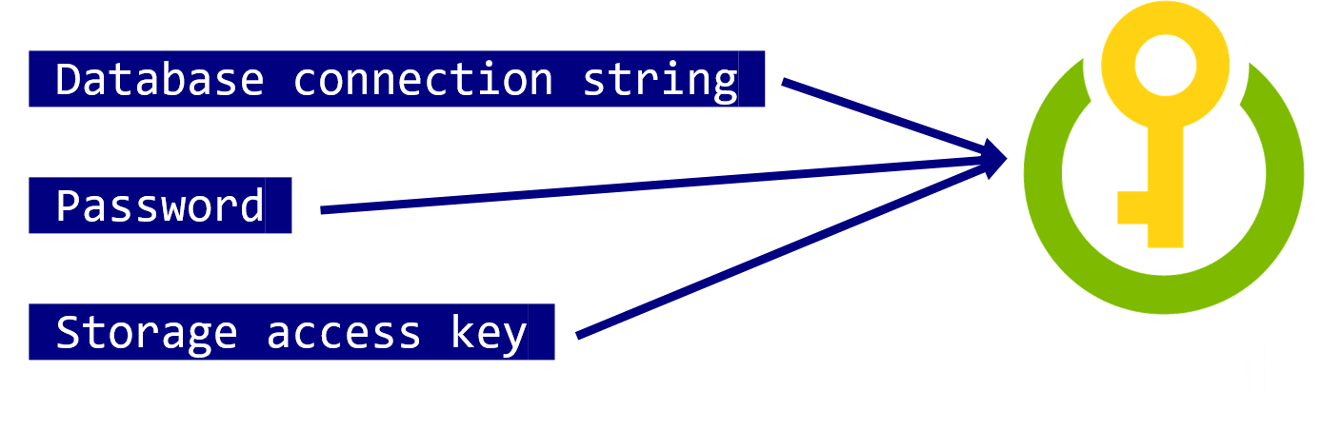
Solução preferida - 3
Aplicativos para celular e Web
Use o Key Vault para armazenar segredos de aplicativos confidenciais, como cadeias de conexão de banco de dados.
Notes:
How would you secure sensitive information used by the web site and APIs?
- Rather than storing sensitive application secrets like credentials and database connection strings in the web.config of the Web and API Apps, Contoso should use Key Vault to store these secrets

Slide 18
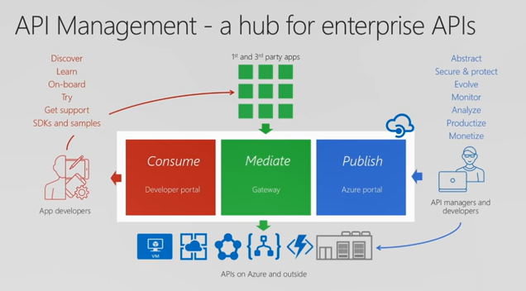

Solução preferida - 4
API Management
A Contoso deve usar o Gerenciamento de API do Azure agora para montar uma solução de prova de conceito.
Azure API Management
Notes:
What recommendations can you make to help Contoso manage its API inventory as it grows in the future? Are there services in Azure that can provide a proof of concept *API Store* experience now and serve as path to development in the future?- Azure API Management has features to help Contoso quickly build and scale an API ecosystem and grow into the future. APIs can be organized into Product groups to provide organization and AAD integration comes out of the box. It will be relatively easy to develop new customer channels for affiliated partners and provide controlled discoverability and lifecycle management to development teams.

Slide 19
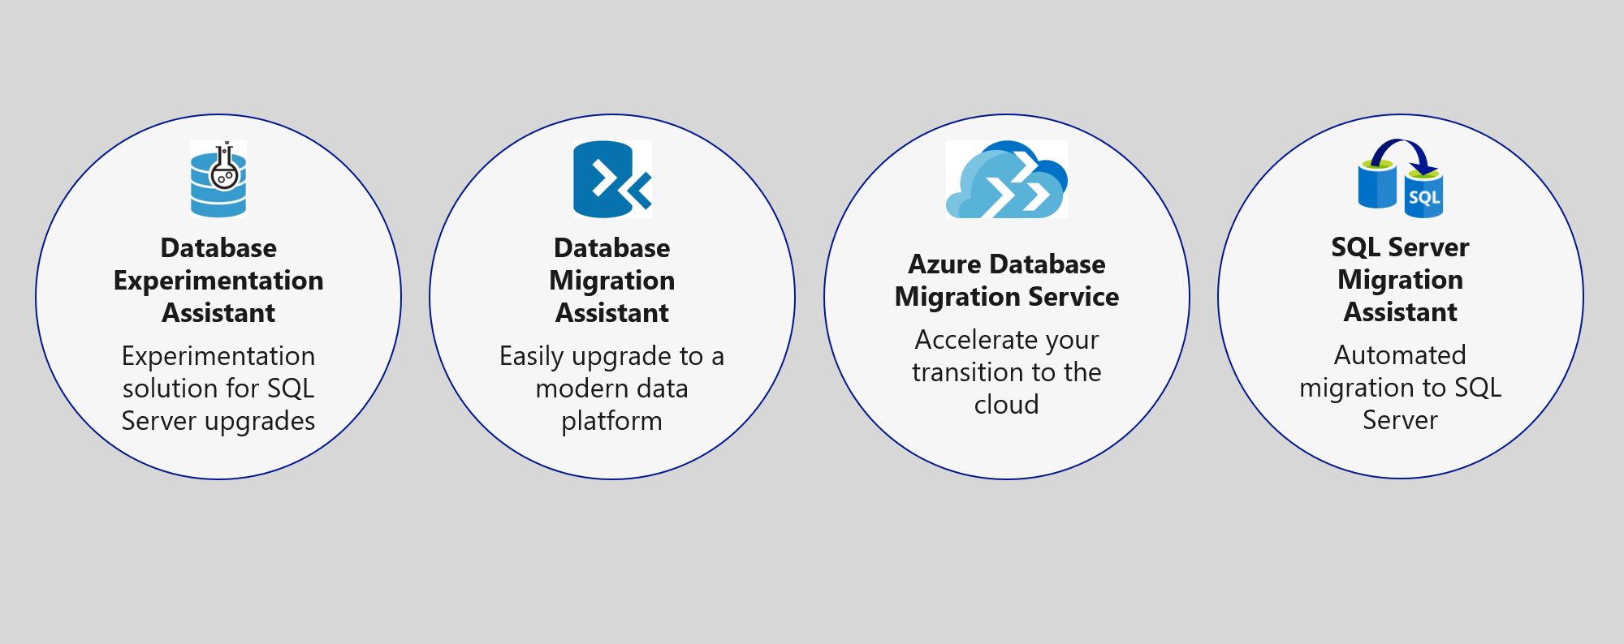
Solução preferida - 5
Gestão de dados
Migrar o banco de dados para Azure SQL usando Database Migration Service

Slide 20
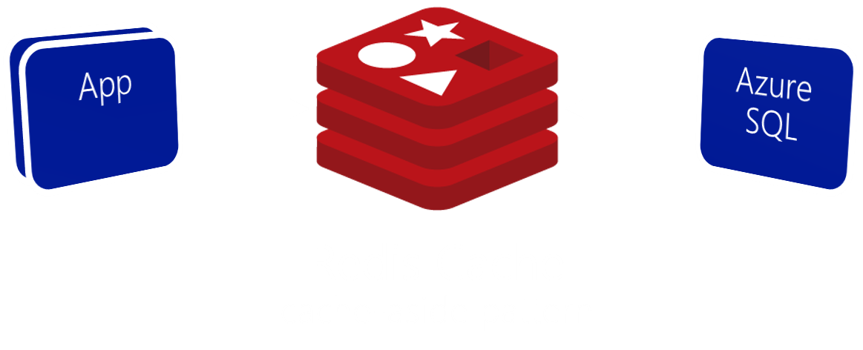
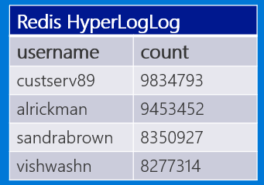
Solução preferida - 6
Gestão de dados
Use Azure Redis Cache para reduzir a carga no banco de dados e implementar placares.
Scoreboard using HyperLogLog
Notes:
What patterns and services would you use to reduce load on the database? Implement the scoreboards?
- Use Azure Redis Cache and the cache-aside pattern.
- Check Azure Redis Cache is first on data requests. Return cached copy if exists, fetch from SQL Database if not, then save to Redis Cache.
- Scoreboards can also be implemented with Azure Redis Cache due to support for fast atomic incrementing of the values for any given string key (e.g., the key would be the username, the value the count). To reduce memory requirements for very large counts, use Redis’ HyperLogLog to store the counted value for each user key.
----------------------------------------------------------------------------------------
- In this approach, as data items are requested, the Azure Redis Cache is first checked to see if it exists there (if it is, then the cached copy is returned). Failing that, the application makes a request directly against SQL Database, but while returning the result to the client it also adds the data item into the Redis Cache.
- Scoreboards can be implemented effectively using Azure Redis Cache because of its support for fast atomic incrementing of the values for any given string key (e.g., the key would be the username, the value the count). To reduce memory requirements for very large counts (such as is possible collecting transaction counts per user in perpetuity), they could use Redis’ HyperLogLog to store the counted value for each user key. The HyperLogLog approximates the cardinality of a set the approximates the count of the number of unique items added (with an error rate less than 1%), and uses a fixed size of 12KB.

Slide 21
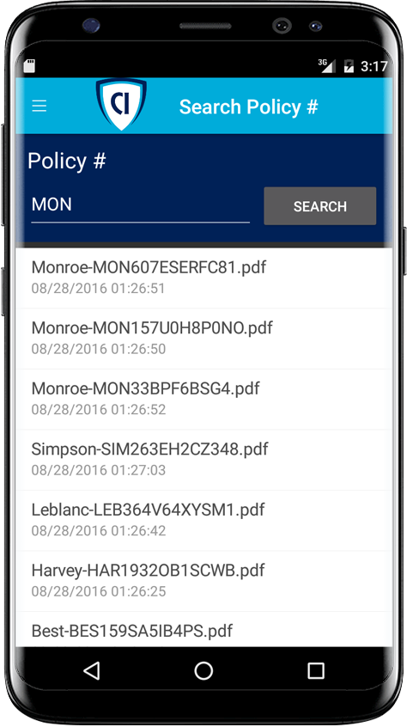

Solução preferida - 7
Busca
Habilite a pesquisa de texto completo de documentos de política com Azure Cognitive Search.
Azure Cognitive Search + Indexer para Azure Storage blobs
Notes:
Given their requirements, how would you enable full text search on the stored policy documents?
- Use Azure Cognitive Search and the Indexer for Azure Storage blobs.
- For files stored in Azure Storage Blobs, this indexer will full-text index PDFs, Microsoft Office Documents (DOCX, DOC, XLSX, XLS, PPTX, PPT and MSG), HTML, XML, ZIP, EML, JSON, and plain text files. They could then use the Azure Cognitive Search .NET SDK from the API App to kick off searches.

Slide 22
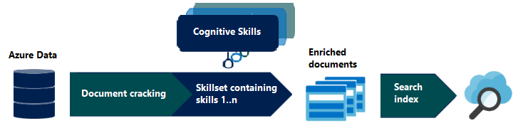
Solução preferida - 8
Busca
Enriqueça o índice de pesquisa com Cognitive Search

Slide 23

Solução preferida - 9
Busca
Habilidades cognitivas personalizadas
Azure Cognitive Search + Functions

Slide 24

Solução preferida - 10
Extensibilidade
Permita que os usuários corporativos criem seus próprios aplicativos móveis internos usando o PowerApps.
Eles podem usar o Microsoft Flow para criar processos automatizados ad-hoc.
Notes:
How would you enable their business users to create their own internal mobile apps that help them streamline their processes without the time and resource investment required for full scale mobile apps?
- PowerApps would enable business users at Contoso to create their own web and mobile apps that support CRUD functionality against data in SQL DB and Azure Storage Blobs.
- Microsoft Flow, which integrates with PowerApps but can also be used stand-alone, would enable them to create automated processes in ad-hoc fashion. Business users could create these for their own use or share them back with the rest of the organization.

Slide 25
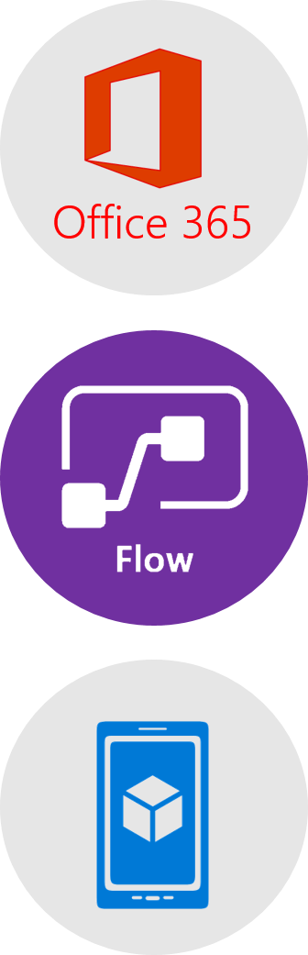
Solução preferida - 11
Extensibilidade
Os usuários corporativos podem criar um fluxo de trabalho de email automatizado com o Microsoft Flow em três etapas fáceis:
Crie um novo fluxo que comece com o Office 365, em novos emails com alta prioridade.
Envie uma ação de notificação por push usando o assunto e o remetente do email.
O usuário instalaria o aplicativo Microsoft Flow para receber notificações.
Notes:
This could be implemented with Microsoft Flow.
The business user would login to Microsoft Flow and create a new flow. It would begin with Office 365, on new email, where the priority flag is set to High.
Then a Push notification – send a push notification action would follow that can use the subject and sender of the email in the subject of the notification.
The user would save this flow. To receive notifications, the user would need to install the Microsoft Flow app on her mobile device.

Slide 26


Tratamento preferencial de objeções
Como podemos automatizar nossos processos?
O Microsoft Flow substituirá os Logic Apps?
Existe realmente uma maneira de armazenar com segurança segredos de aplicativos na nuvem?
Como podemos ficar no topo de um crescente ecossistema de API?
Não temos todos os recursos SQL disponíveis para nós na nuvem.
Qual estrutura .NET devemos escolher?
Notes:
* Microsoft Flow allows business users to automate their processes.
* Flow will not replace Logic Apps. Logic Apps represent an “advanced” version of Microsoft Flow, providing support for more developer centric tasks, such as integrating API Apps as custom actions, whereas Flow only provides pre-built actions.
* Azure Key Vault provides a mechanism to store secrets encrypted and securely stored within the confines of specialized hardware called Hardware Security Modules (HSM). * A proof of concept that demonstrates the capabilities of Azure API Management can be put together quickly and can easily be scaled up to create the API Store experience Contoso is looking for.
* It is likely that a feature that was previously built into SQL Server and used from applications directly now runs external to Azure SQL Database in the form of a separate Azure service. Examples include:
Linked servers- are not supported by SQL Server, but cross database read-only querying is possible using elastic database query.
Database Mail- which was used to send email directly from SQL Server is not supported, but there are multiple alternatives (such as using Office 365 and SendGrid) that applications can use to send emails.
SQL Server Agent Jobs- these background processes can usually be migrated to a Web Job (running within an App Service), Azure Functions, or to Cloud Service Worker Role.
Service Broker- numerous alternative messaging options exist in Azure, including Azure Storage Queues and Azure Service Bus Brokered Messaging.

Slide 27
Feedback do cliente
“A Microsoft fez um trabalho brilhante com a tecnologia que eles colocaram na nuvem. Nossos aplicativos hospedados no Azure são modificáveis, interoperáveis e seguros. Não poderíamos estar mais felizes executando o PolicyConnect no Azure.”
Charlene Mathis, General Manager, Contoso, Ltd.

